Slide 1

Deep Learning & LLMs 1
Applied Text Mining & NLP
from Foundations to Advanced
Robert Bagheri
2026
Notes:
Video by Google DeepMind from Pexels: https://www.pexels.com/video/an-artist-s-animation-of-artificial-intelligence-ai-this-video-depicts-language-models-which-generate-text-it-was-created-by-wes-cockx-as-part-of-the-visualising-ai-project-launched-by-18069700/

Slide 2
This lecture
Introduction to neural networks
Feed-forward & deep neural networks
Recurrent neural networks

Slide 3
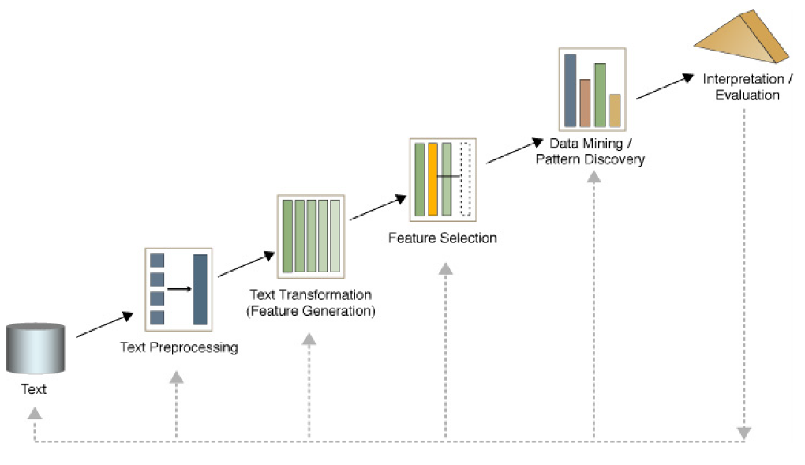
Text mining process

Slide 4
Introduction

Slide 5
Why should we learn this?
State-of-the-art performance on various tasks
Text prediction (your phone’s keyboard)
Forecasting
Spam filtering
Compression (dimension reduction)
Text generation
Translation
…

Slide 6
https://thispersondoesnotexist.com/

Slide 7
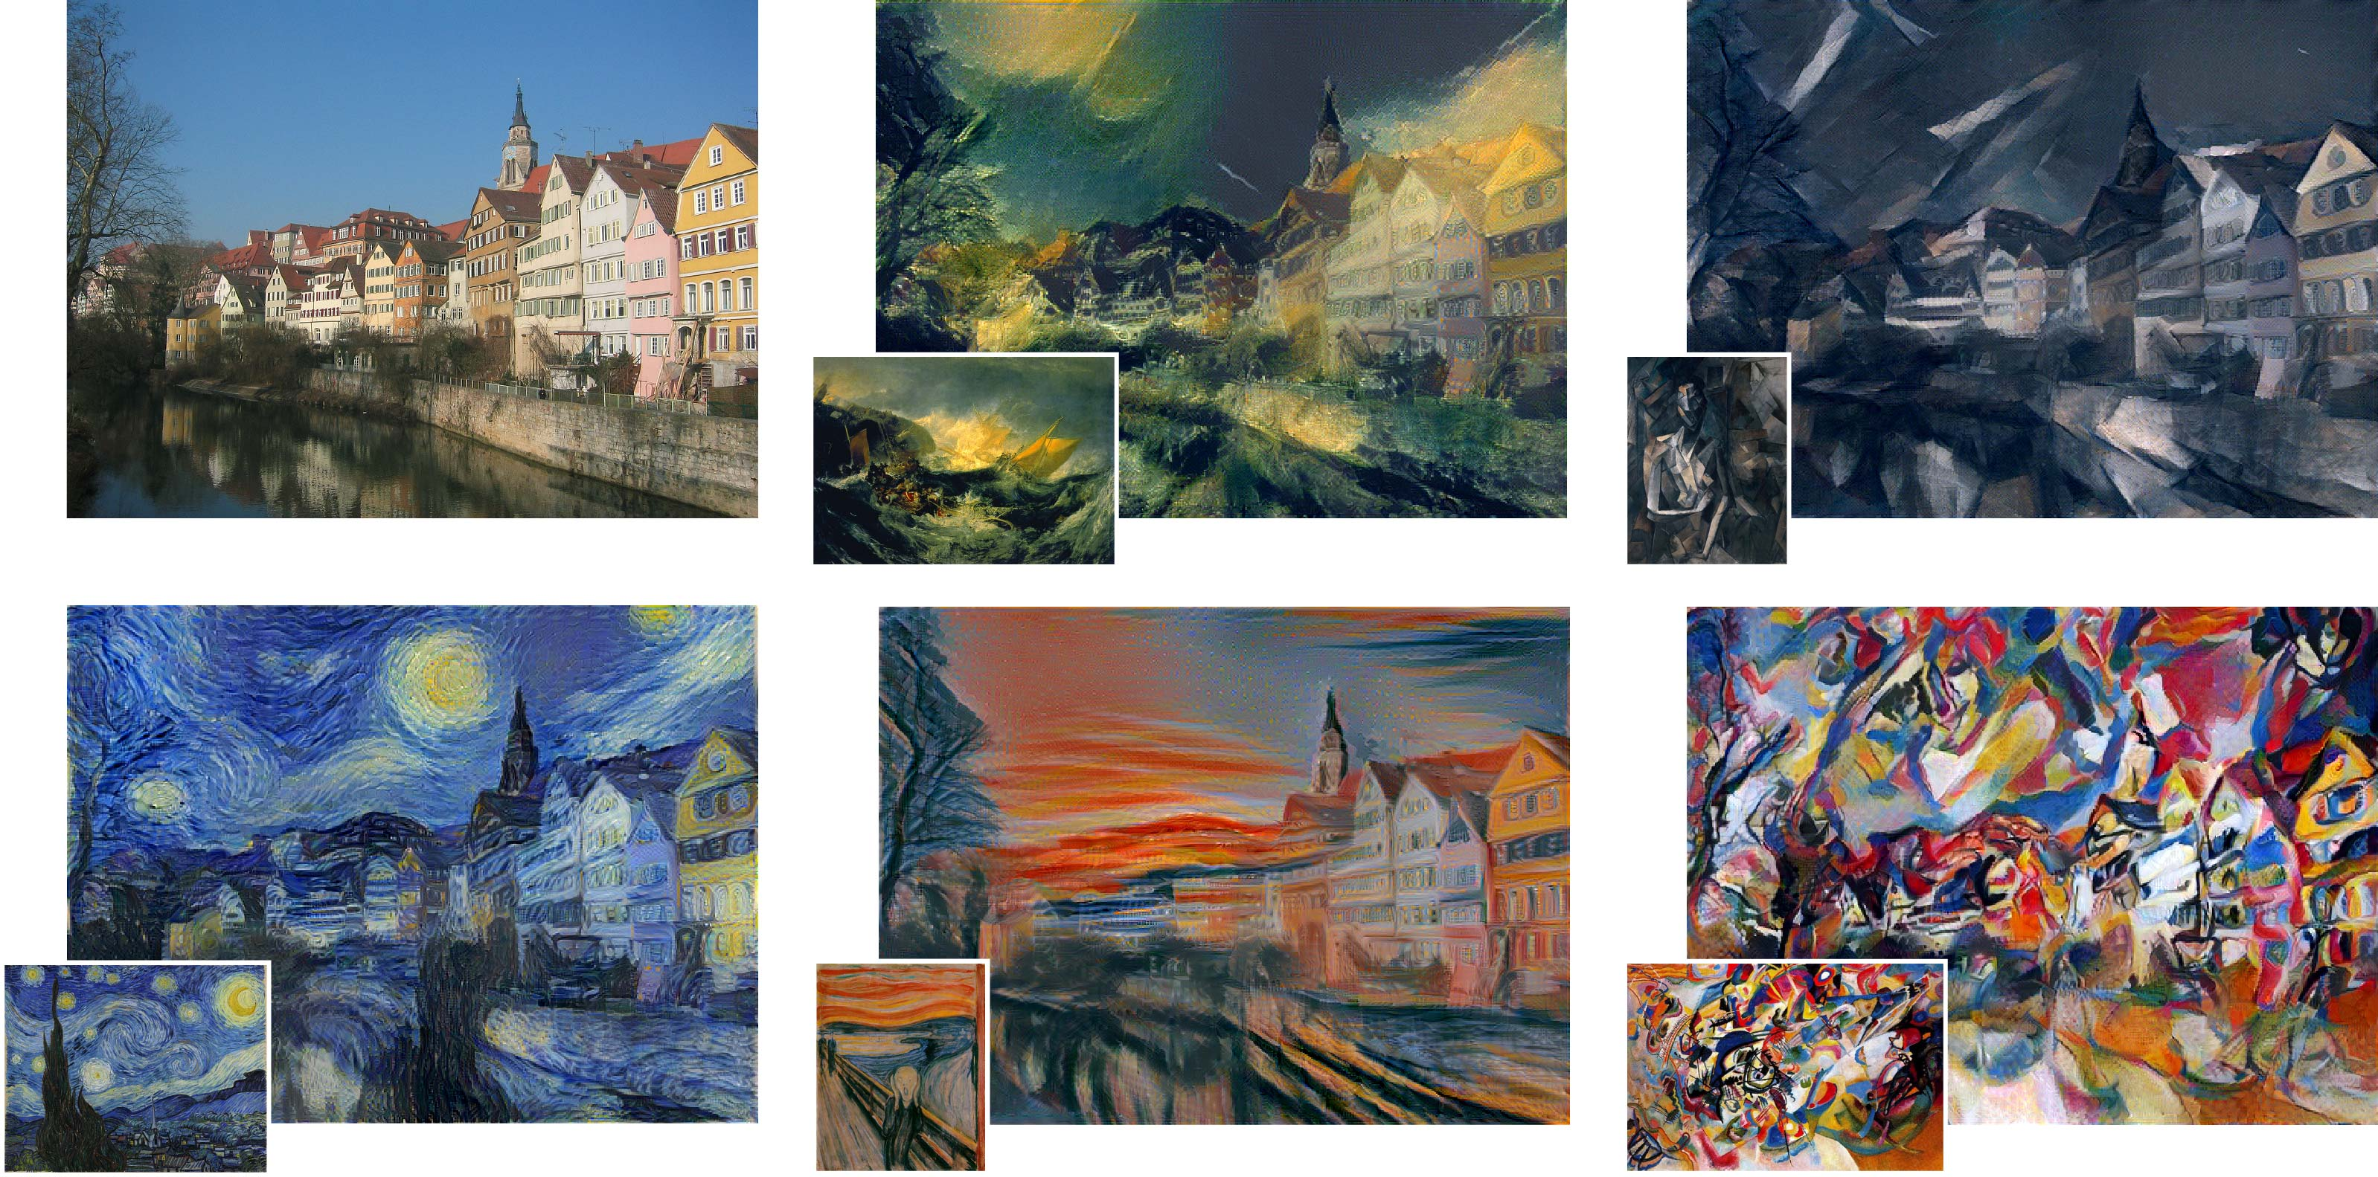
http://bethgelab.org

Slide 8
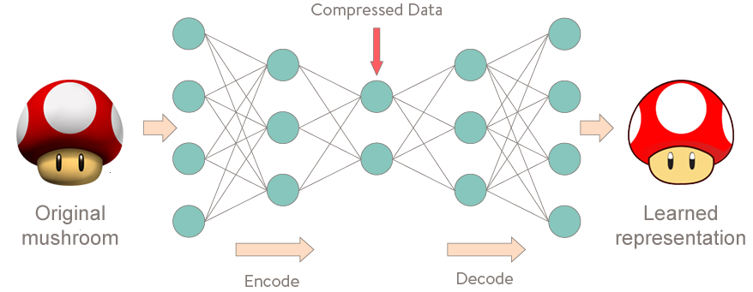
https://community.canvaslms.com/t5/Canvas-Developers-Group/Canvas-LMS-Cheat-Detection-System-In-Python/m-p/118134

Slide 9
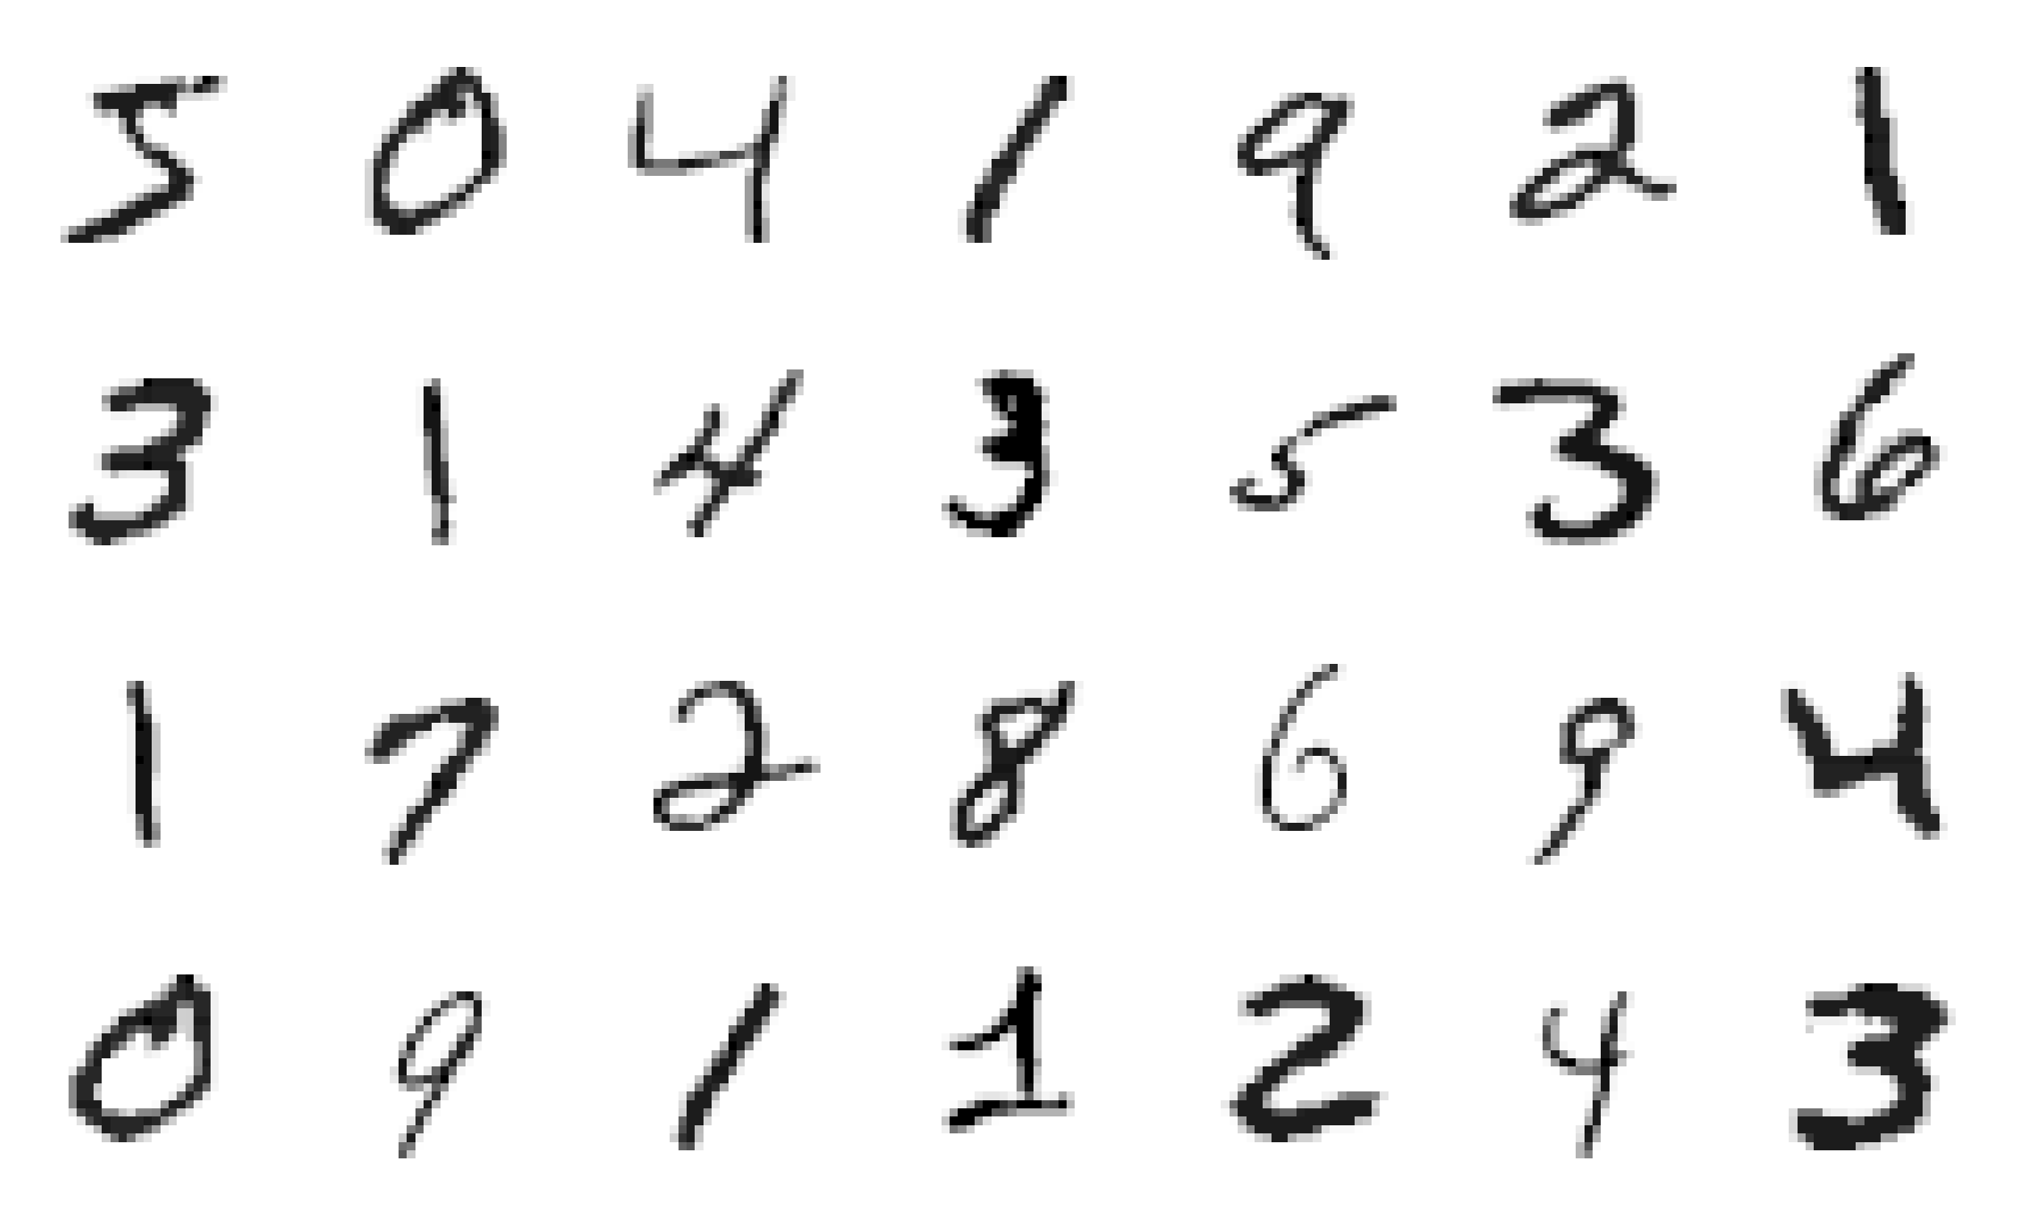
“Hello world” of neural networks
MNIST (Modified National Institute of Standards and Technology)
Handwritten digits
28 * 28 pixels
60 000 training images and 10 000 testing images

Slide 10
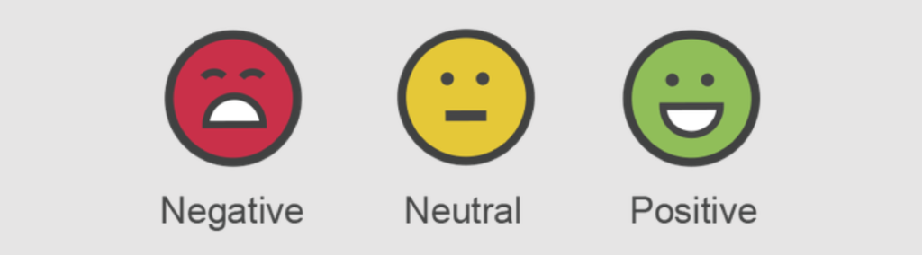
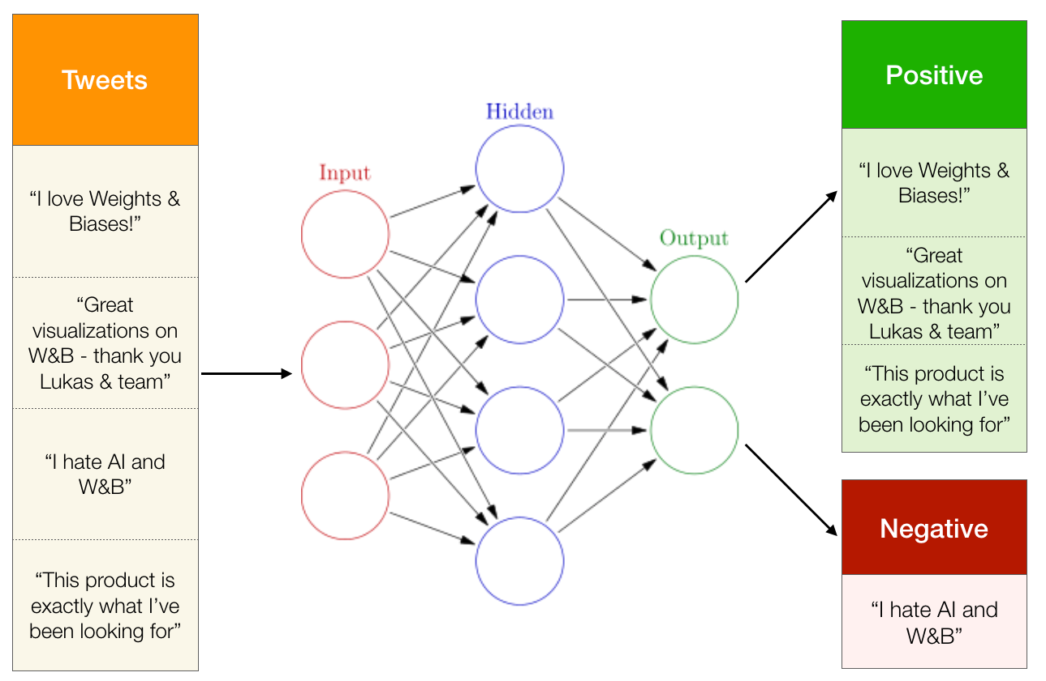
“Hello world” of neural networks for text: Sentiment classification with LSTM

Slide 11
So what is a neural network?

Slide 12
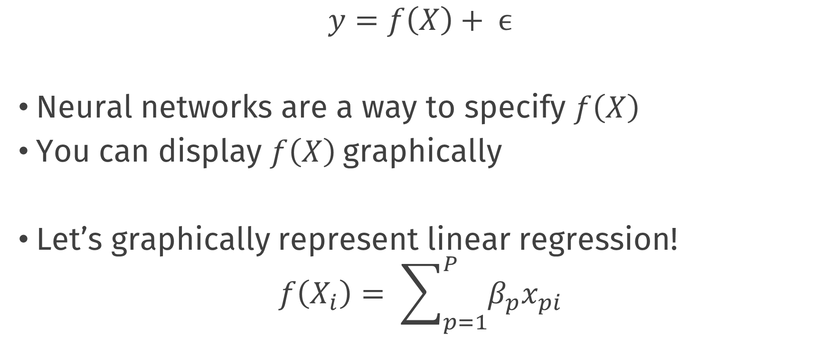
Neural networks
$$y=f\left(X\right)+ ϵ$$
Neural networks are a way to specify $f\left(X\right)$
You can display $f\left(X\right)$graphically
Let’s graphically represent linear regression!
$$f\left(X_{i}\right)= \sum_{p=1}^{P}{β_{p}x_{pi}}$$

Slide 13
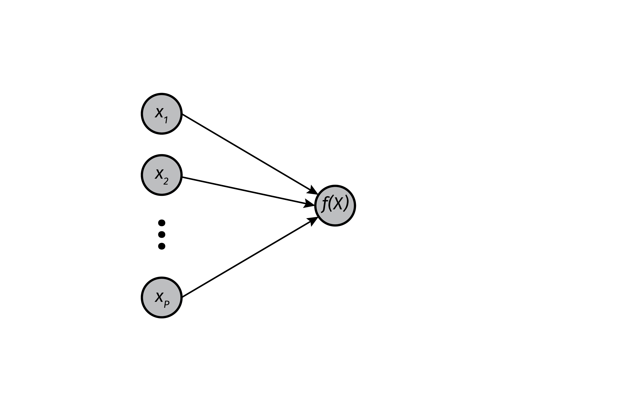

Linear regression as neural net
Graphical representation
Parameters are arrows
Arrows ending in a node are summed together
Intercept is not drawn
$$f\left(X_{i}\right)=α+\sum_{p=1}^{P}{β_{p}x_{pi}}$$

Slide 14

Linear regression as neural net
Neural network jargon
Parameter = weight
Intercept = bias
$$f\left(X_{i}\right)=β+\sum_{p=1}^{P}{w_{p}x_{pi}}$$

Slide 15
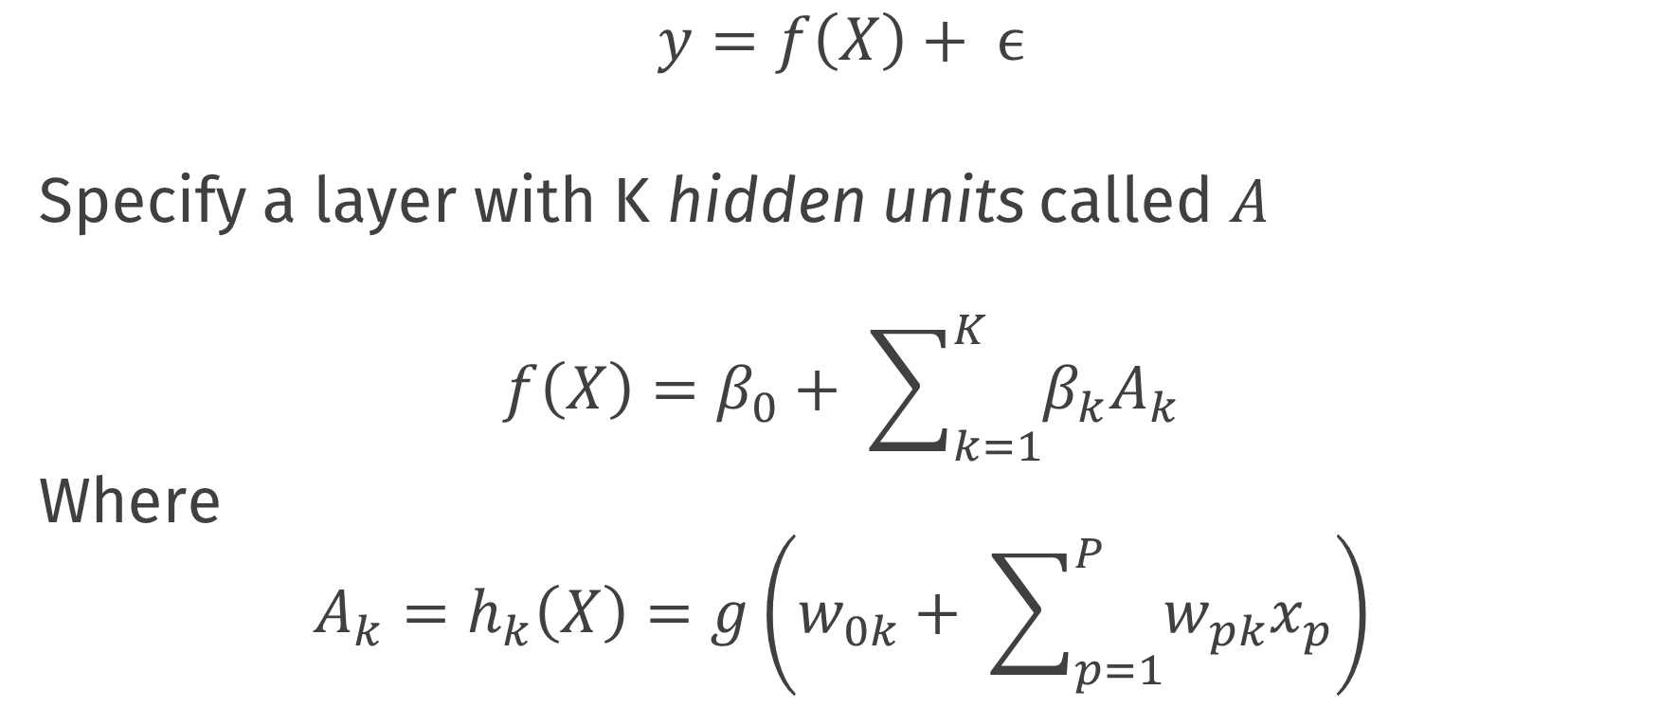
Single layer neural networks
$$y=f\left(X\right)+ ϵ$$
Specify a layer with K hidden units called $A$
$$f\left(X\right)=β_{0}+ \sum_{k=1}^{K}{β_{k}A_{k}}$$
Where
$$A_{k}=h_{k}\left(X\right)=g\left(w_{0k}+ \sum_{p=1}^{P}{w_{pk}x_{p}}\right)$$

Slide 16
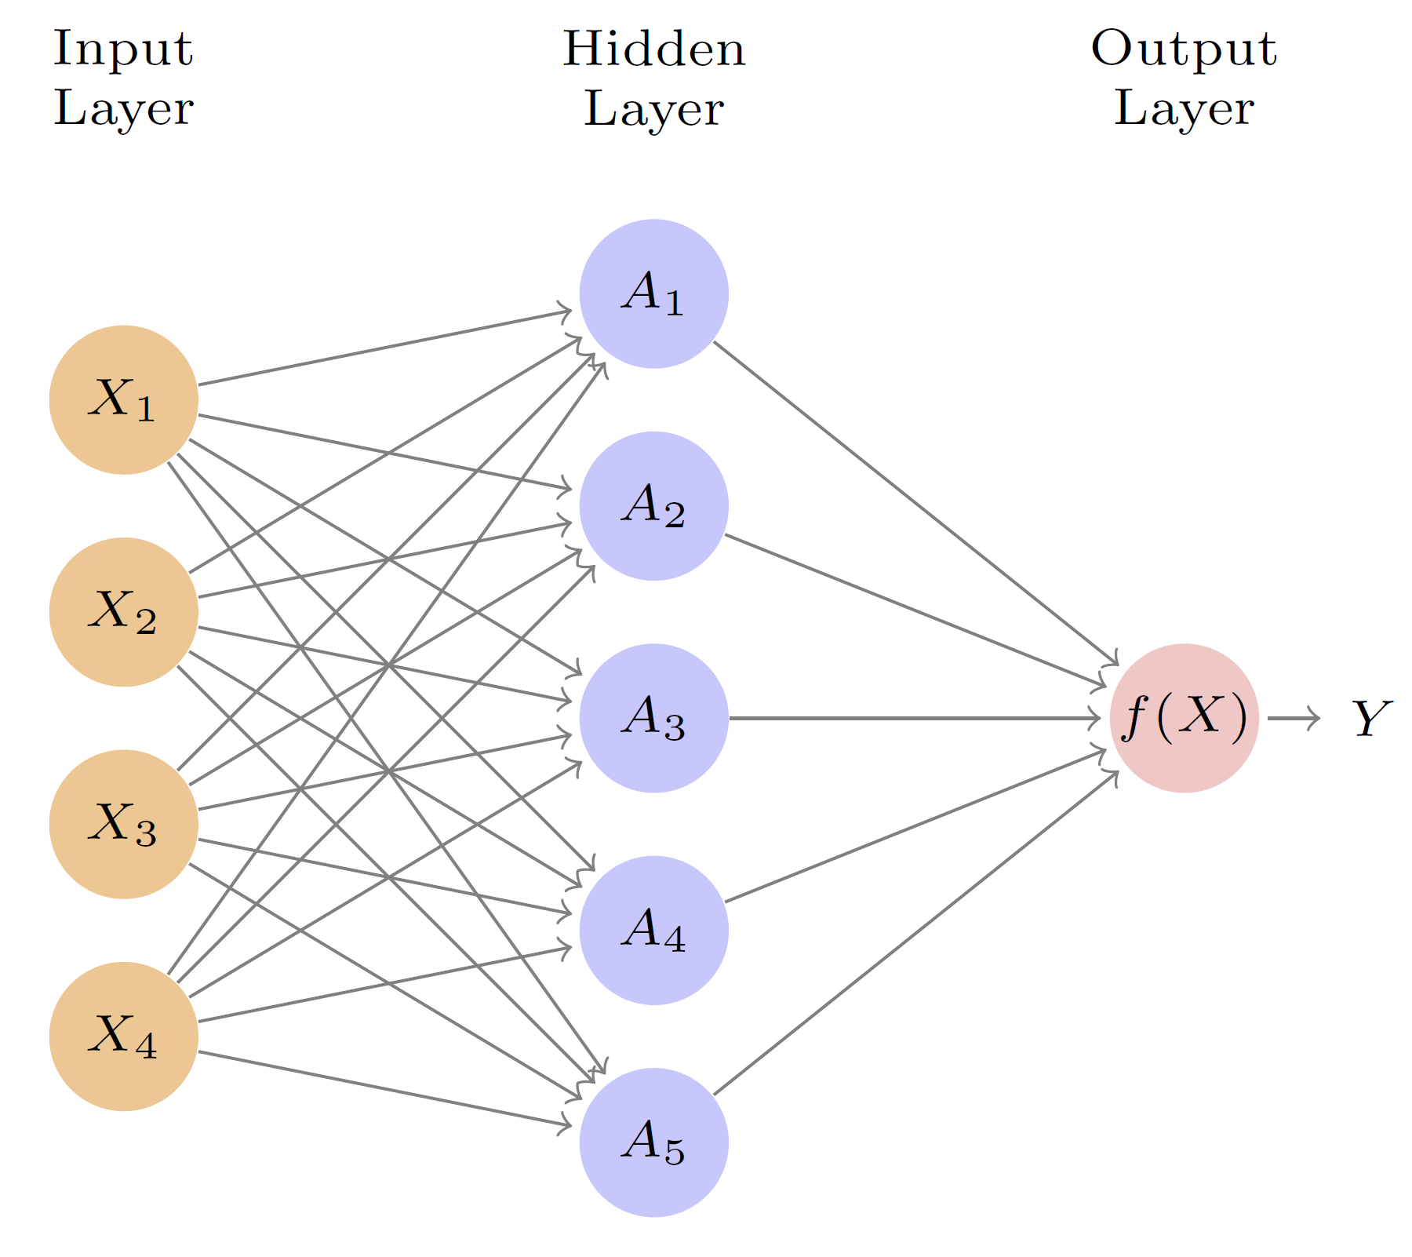
Single layer neural networks

Slide 17
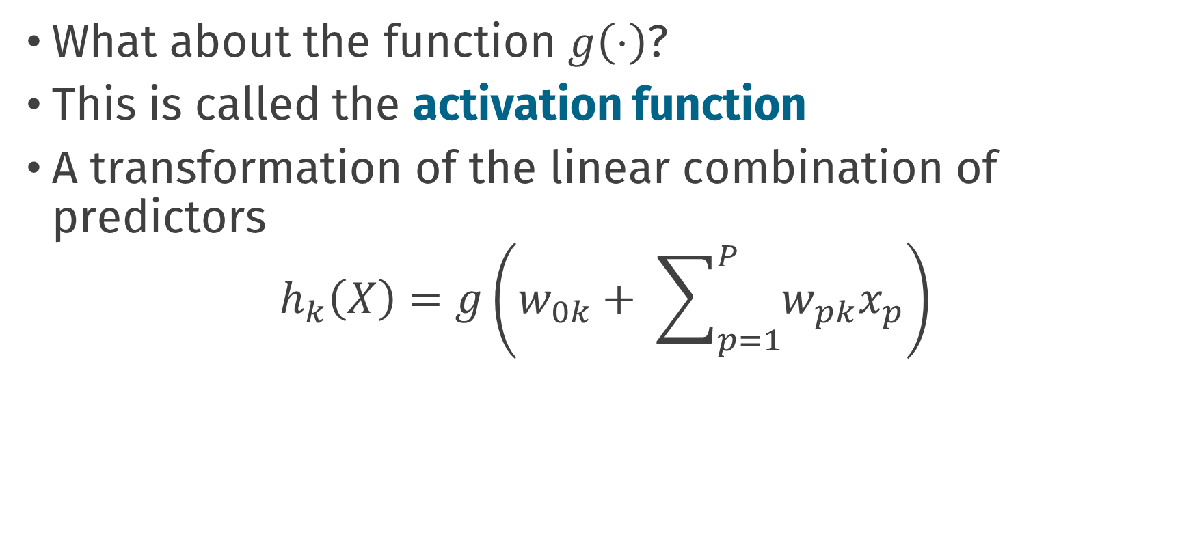
Single layer neural networks
What about the function $g\left(⋅\right)$?
This is called the activation function
A transformation of the linear combination of predictors
$$h_{k}\left(X\right)=g\left(w_{0k}+ \sum_{p=1}^{P}{w_{pk}x_{p}}\right)$$

Slide 18
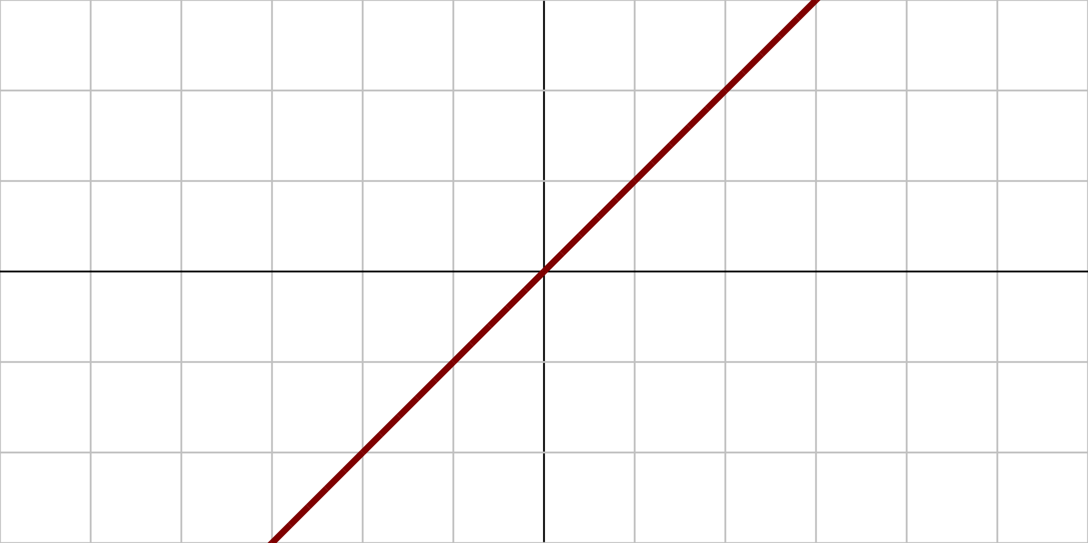
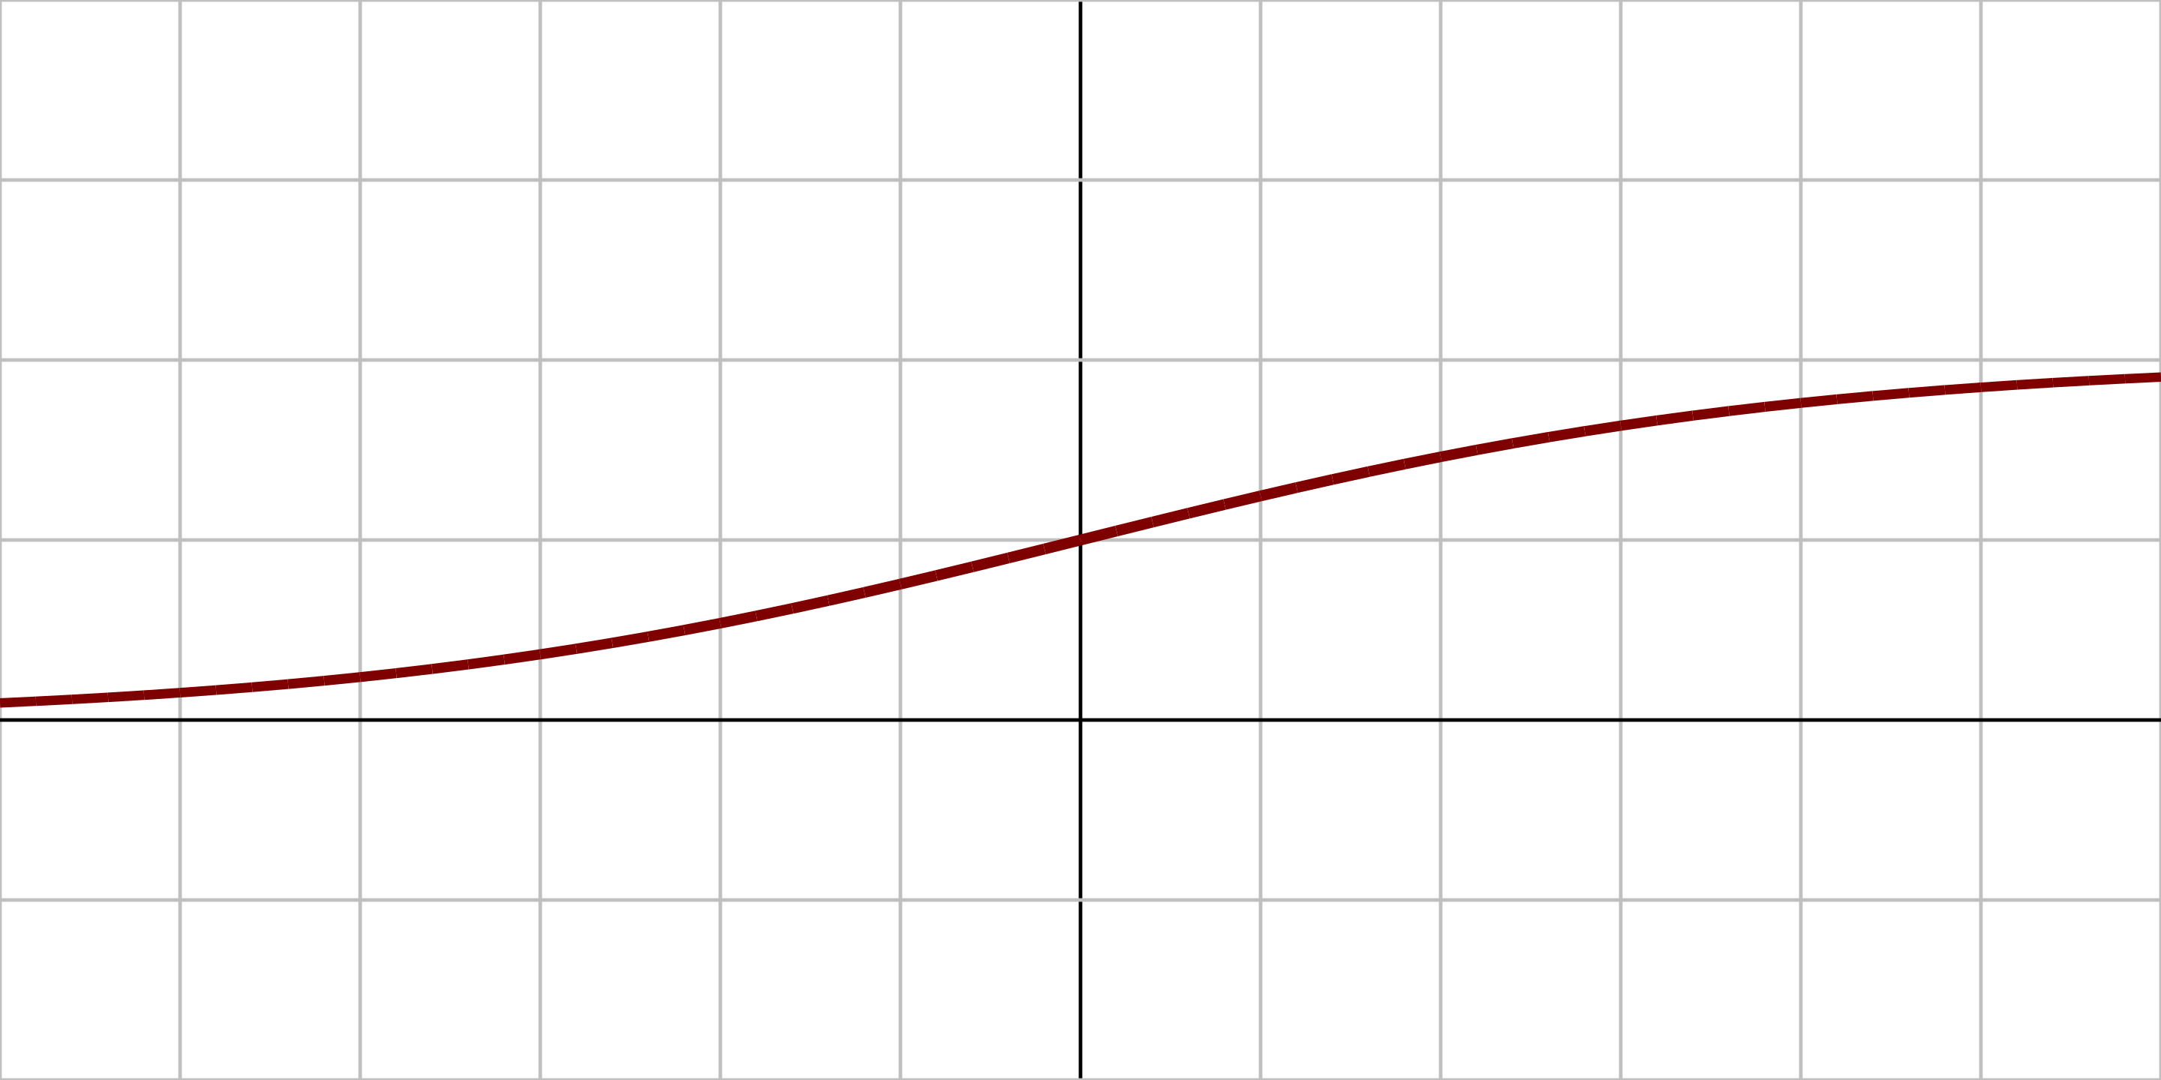
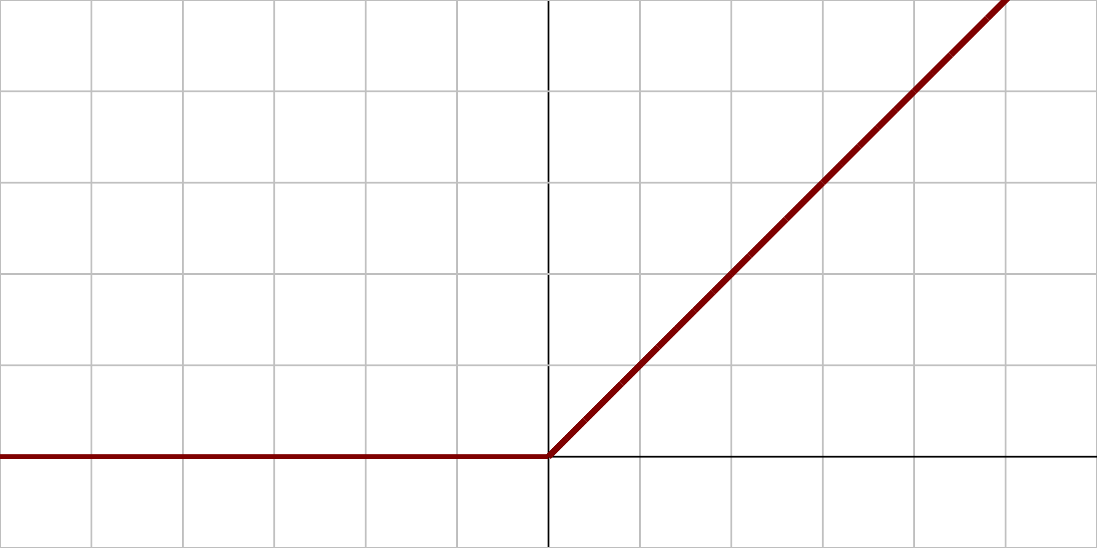



Activation functions
Linear: $g\left(x\right)=x$
Sigmoid: $g\left(x\right)=\frac{1}{1+e^{−x}}$
ReLu: $g\left(x\right)=max(0,x)$
Rectified linear (ReLu) is most popular nowadays
Nonlinearity necessary! Otherwise: collapse to linear regression

Slide 19
Single layer neural networks

Slide 20
Feed-forward Neural Networks

Slide 21
Feed-forward neural networks
We can go deeper
More hidden layers after one another
Higher-order features composed of lower-order features
Universal function approximation theorem, version 2
Any “well-behaved” function can be represented by neural net of sufficient depth with nonlinear activation function
(deep neural nets may be more tractable than wide)

Slide 22
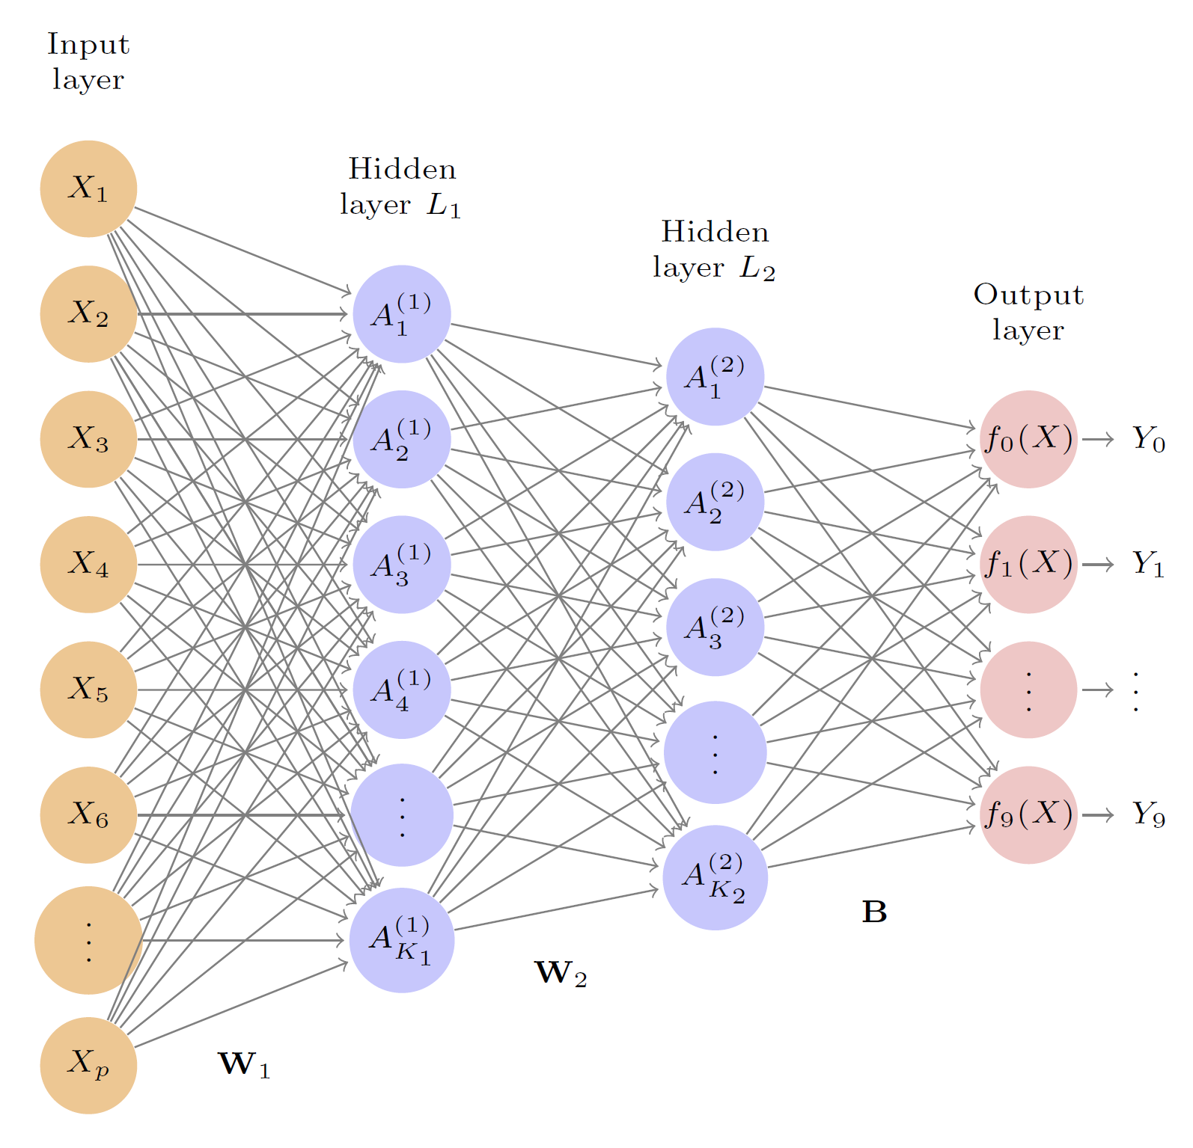
Feed-forward neural networks

Slide 23

Feed-forward neural networks
Feed-forward network architecture defined by:
Number of layers
Number of hidden units in each layer
Activation function for each layer
Activation function for output layer

Slide 24
Keras!
import(keras)
model_dff =
keras_model_sequential() %>%
layer_flatten(input_shape = c(28, 28)) %>%
layer_dense(units = 256, activation = "relu") %>%
layer_dense(units = 128, activation = "relu") %>%
layer_dense(10, activation = "softmax")

Slide 25
Keras!
summary(model_dff)
Layer (type) Output Shape Param #
======================================================================================
flatten (Flatten) (None, 784) 0
______________________________________________________________________________________
dense_1 (Dense) (None, 256) 200960
______________________________________________________________________________________
dense_2 (Dense) (None, 128) 32896
______________________________________________________________________________________
dense_3 (Dense) (None, 10) 1290
======================================================================================
Total params: 235,146
Trainable params: 235,146
Non-trainable params: 0
______________________________________________________________________________________

Slide 26
How to estimate parameters?

Slide 27
Estimating parameters
We need some way to measure how well the network does
Parameters that make the network perform well are good!

Slide 28
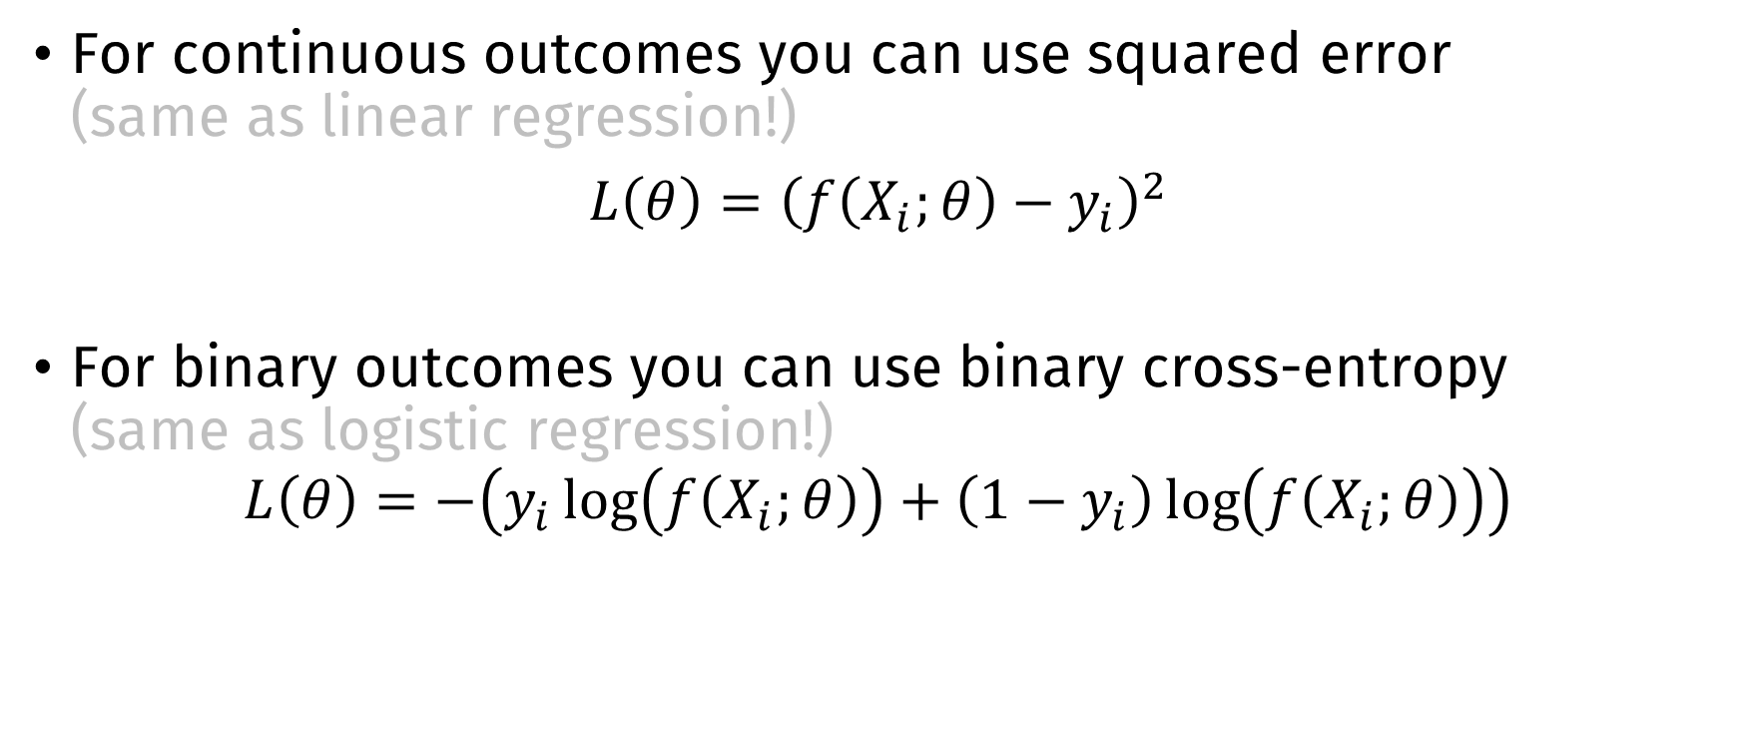
Loss function
For continuous outcomes you can use squared error (same as linear regression!)
$L\left(θ\right)={\left(f\left(X_{i};θ\right)−y_{i}\right)}^{2}$
For binary outcomes you can use binary cross-entropy (same as logistic regression!)
$$L\left(θ\right)=−\left(y_{i}\log\left(f\left(X_{i};θ\right)\right)+\left(1−y_{i}\right)\log\left(f\left(X_{i};θ\right)\right)\right)$$

Slide 29
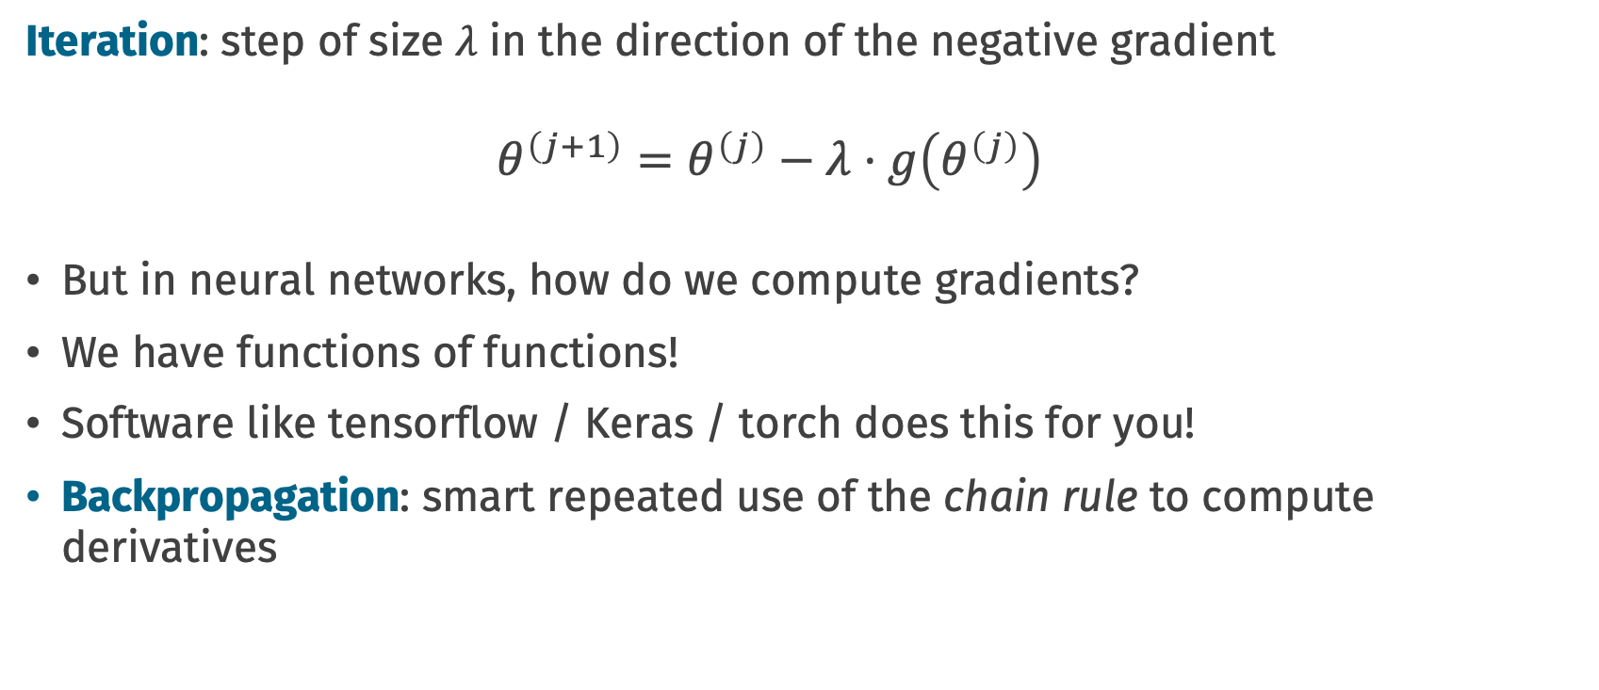
Gradient descent
Iteration: step of size 𝜆 in the direction of the negative gradient
$$θ^{\left(j+1\right)}=θ^{\left(j\right)}−λ⋅g\left(θ^{\left(j\right)}\right)$$
But in neural networks, how do we compute gradients?
We have functions of functions!
Software like tensorflow / Keras / torch does this for you!
Backpropagation: smart repeated use of the chain rule to compute derivatives

Slide 30
Break

Slide 31
Recurrent Neural Network (RNN)

Slide 32
Recurrent Neural Network
Another famous architecture of Deep Learning
Preferred algorithm for sequential data
time series, speech, text, financial data, audio, video, weather and much more.
text: sentiment analysis, sequence labeling, speech tagging, machine translation, etc.
Maintains internal memory, thus can remember its previous inputs

Slide 33
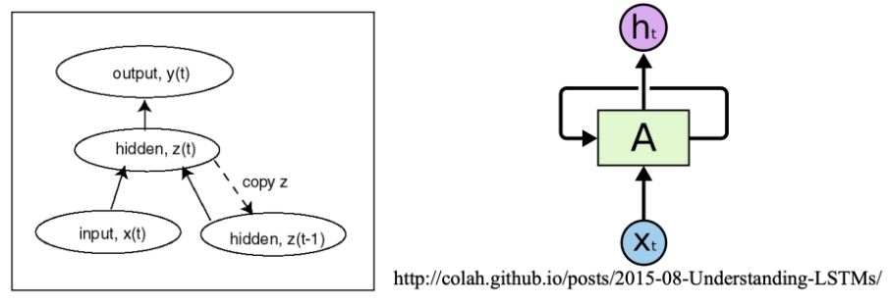
Simple recurrent network

Slide 34
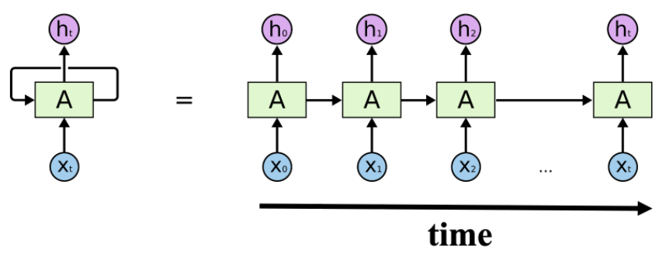
Simple recurrent network

Slide 35
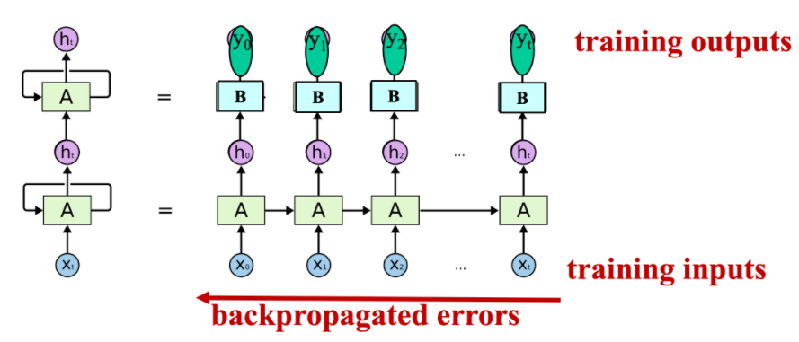
Training RNNs
RNNs can be trained using “backpropagation through time.”
Can viewed as applying normal backprop to the unrolled network.

Slide 36
The problem of Vanishing Gradient
Consider a RNN model for a machine translation task from English to Dutch.
It has to read an English sentence, store as much information as possible in its hidden activations, and output a Dutch sentence.
The information about the first word in the sentence doesn’t get used in the predictions until it starts generating Dutch words.
There’s a long temporal gap from when it sees an input to when it uses that to make a prediction.
It can be hard to learn long-distance dependencies.
In order to adjust the input-to-hidden weights based on the first input, the error signal needs to travel backwards through this entire pathway.

Slide 37
Long Short-Term Memory (LSTM)

Slide 38
Long Short-Term Memory
Prevents vanishing/exploding gradient problem by:
introducing a gating mechanism
turning multiplication into addition
Designed to make it easy to remember information over long time periods until it’s needed.
The activations of a network correspond to short-term memory, while the weights correspond to long-term memory.

Slide 39
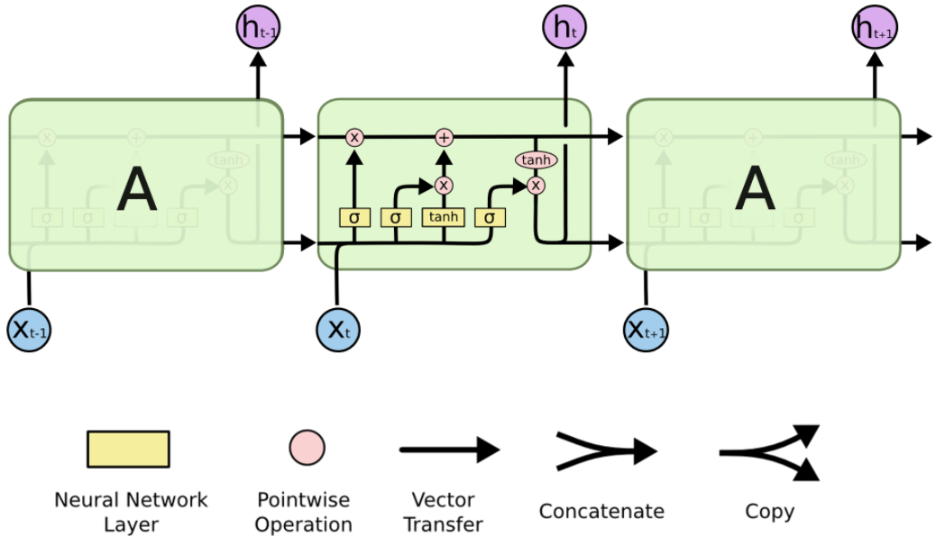
LSTM architecture
https://colah.github.io/posts/2015-08-Understanding-LSTMs/

Slide 40
Extensions
Bi-directional network: separate LSTMs process forward and backward sequences, and hidden layers at each time step are concatenated to form the cell output.
Gated Recurrent Unit (GRU): alternative RNN to LSTM that uses fewer gates, combines forget and input gates into “update” gate, eliminates cell state vector.
Attention: Allows network to learn to attend to different parts of the input at different time steps, shifting its attention to focus on different aspects during its processing.

Slide 41
State-of-the-Art
Recurrent neural networks
LSTM
GRU
Bi-directional network
Transformers
Contextual embeddings
Large Language Models (LLMs) --> GPT, QWEN, MISTRAL, DEEPSEEK, …

Slide 42
Conclusion
Neural networks are popular methods especially for text mining
Feed-forward & RNN & CNN (afternoon)
RNN works better for text data

Slide 43
Practical 7

Slide 44
Questions?

